Slide 1



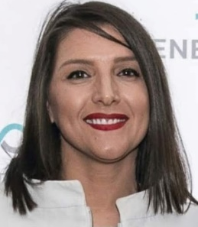
NANOBASED DRUG DELIVERY SYSTEMS: DEVELOPMENT AND CHARACTERIZATION
Contact person/Group leader:
Prof. Asoc. Dr. Mimoza BASHOLLI-SALIHU
Affiliation
Department of Pharmaceutical Technology, Faculty of Medicine, University of Prishtina, Kosovo
Department of Drug Analytics and Pharmaceutical Legislation, Faculty of Medicine, University of Prishtina, Kosovo
Mail address
mimoza.basholli@uni-pr.edu; mbasholli@yahoo.com
Email/website
https://staff.uni-pr.edu/profile/mimozabasholli-salihu
Group Members
Prof. Asst. Dr. Aida Loshaj-Shala, Asst. Dr. Sc. Toskë Kryeziu, PhD cand. Venesa Lupçi
Google Scholar
https://scholar.google.co.uk/citations?user=sBEndvcAAAAJ&hl=en&oi=ao
Research Gate
https://www.researchgate.net/profile/Mimoza-Basholli-Salihu
Research lines
Polymer based and lipid based nano delivery systems to improve biological activity of plant extracts and their components
Establishment of methodology for evaluation of stability and release profile of diverse nanoformulations
Development of successful nano-formulations to enhance the efficacy and safety of drugs
Establish a nano-technological laboratory, needed for practical teaching;
Development of Tissue nanodrug delivery assessment methodology
Pharmacokinetic research on nano-delivery systems for herbal medicines

